Slide 1
8-28-2024 Chassis Changes

Slide 2
¼” total width dimension increase
yipee

Slide 3
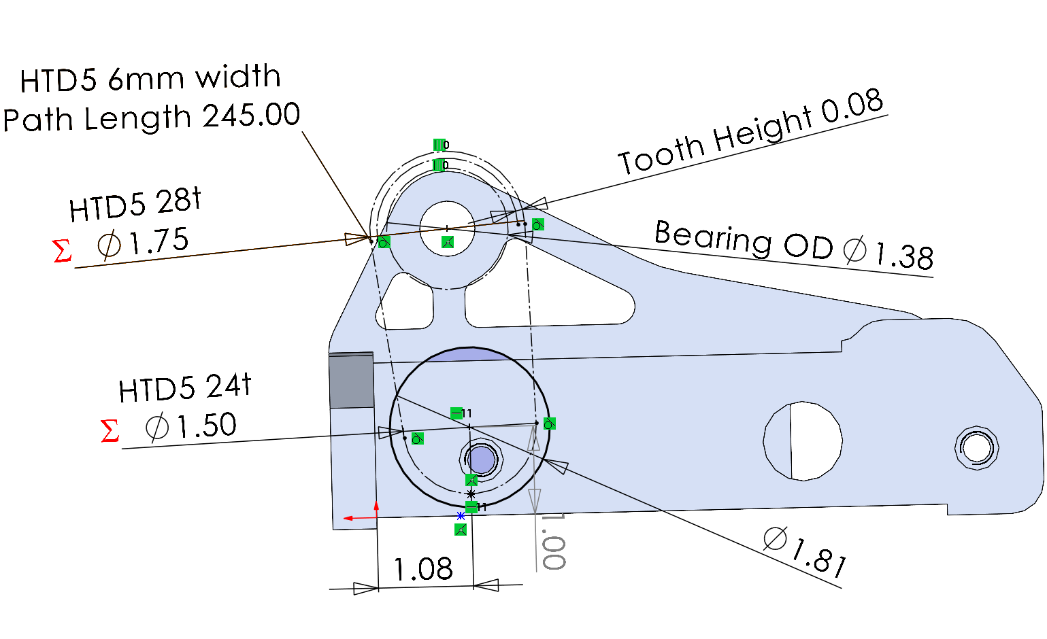
Belts
https://www.vbeltguys.com/products/245-5m-06-synchronous-timing-belt

Slide 4
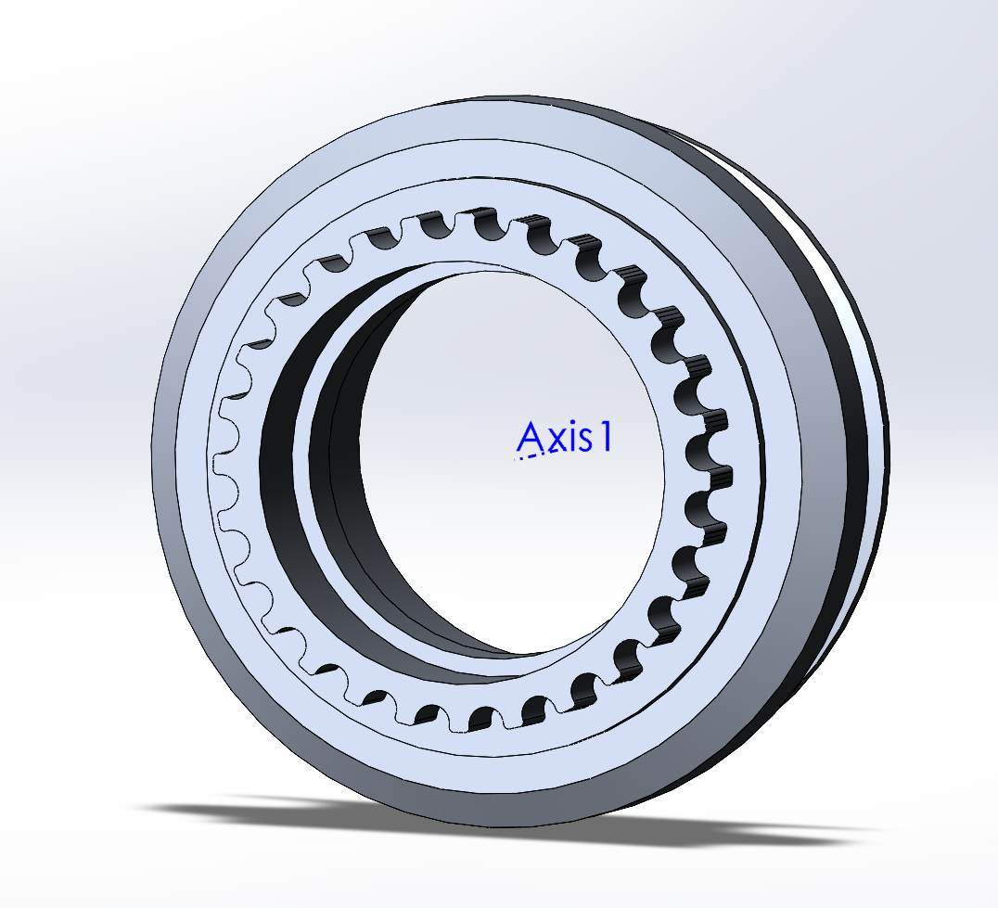
Smalelr bearing
https://www.servocity.com/5-8-id-x-7-8-od-non-flanged-ball-bearing-2-pack/
ID Insert to use a diff bearing
Needles?
M2 bolts lmao
Or just make pulley size larger

Slide 5
Todo
Motor support plate
CAD new pullies

